Slide 1

Subject Name : Data Structures and Algorithms
Subject Code : 22CSE108
Total Contact Hours : 45
Credits : 03 L-T-P : 1-1-2
FACULTY OF
ENGINEERING
AND TECHNOLOGY

Slide 2
Module - 5
File Structures
FACULTY OF
ENGINEERING
AND TECHNOLOGY

Slide 3

File System
Computers can store information on various storage media such as, magnetic disks, magnetic tapes, optical disks.
The physical storage is converted into a logical storage unit by operating system.
The logical storage unit is called FILE.
A file is a collection of similar records.
A record is a collection of related fields that can be treated as a unit by some application program.
A field is some basic element of data.
Student name, Marks in sub1, sub2, Fail/Pass is fields. The collection of fields is called a RECORD.
Collection of these records is called a data file.
FACULTY OF
ENGINEERING
AND TECHNOLOGY

Slide 4
File System
FILE ATTRIBUTES :
Name : A file is named for the convenience of the user and is referred by its name. A name is usually a string of characters.
Identifier : This unique tag, usually a number ,identifies the file within the file system.
Type : Files are of so many types. The type depends on the extension of the file.
Example: .exe Executable file .obj Object file .src Source file
Location : This information is a pointer to a device and to the location of the file on that device.
Size : The current size of the file (in bytes, words,blocks).
Protection : Access control information determines who can do reading, writing, executing and so on.
Time, Date, User identification : This information may be kept for creation, last modification,last use.
FACULTY OF
ENGINEERING
AND TECHNOLOGY

Slide 5
File System
FILE OPERATIONS
Creating a file : Two steps are needed to create a file.
Check whether the space is available or not.
If the space is available then made an entry for the new file in the directory. The entry includes name of the file, path of the file,etc…
Writing a file : To write a file, we have to know 2 things.
One is name of the file and second is the information or data to be written on the file, the system searches the entire given location for the file.
If the file is found, the system must keep a write pointer to the location in the file where the next write is to take place.
FACULTY OF
ENGINEERING
AND TECHNOLOGY

Slide 6
File System
FILE OPERATIONS
Reading a file : To read a file,
first of all we search the directories for the file, if the file is found, the system needs to keep a read pointer to the location in the file where the next read is to take place.
Once the read has taken place, the read pointer is updated.
Repositioning within a file :
The directory is searched for the appropriate entry and the current file position pointer is repositioned to a given value.
This operation is also called file seek.
Deleting a file : To delete a file, first of all search the directory for named file, then released the file space and erase the directory entry.
Truncating a file : To truncate a file, remove the file contents only but, the attributes are as it is.
FACULTY OF
ENGINEERING
AND TECHNOLOGY

Slide 7
File System
FILE ACCESS METHODS
Files stores information, this information must be accessed and read into computer memory.
There are so many ways that the information in the file can be accessed.
Sequential file access:
Information in the file is processed in order i.e. one record after the other.
Magnetic tapes are supporting this type of file accessing.
Eg : A file consisting of 100 records, the current position of read/write head is 45th record, suppose we want to read the 75th record then, it access sequentially from 45, 46, 47 …….. 74, 75.
FACULTY OF
ENGINEERING
AND TECHNOLOGY

Slide 8
File System
So the read/write head traverse all the records between 45 to 75.
Direct access:
Direct access is also called relative access.
Here records can read/write randomly without any order.
The direct access method is based on a disk model of a file, because disks allow random access to any file block.
Eg : A disk containing of 256 blocks, the position of read/write head is at 95th block.
The block is to be read or write is 250th block.
Then we can access the 250th block directly without any restrictions.
FACULTY OF
ENGINEERING
AND TECHNOLOGY

Slide 9
File System
Eg : CD consists of 10 songs, at present we are listening song 3, If we want to listen song 10, we can shift to 10.
Indexed Sequential File access :
The main disadvantage in the sequential file is, it takes more time to access a Record .
Records are organized in sequence based on a key field.
Eg :
A file consisting of 60000 records, the master index divide the total records into 6 blocks, each block consisting of a pointer to secondary index.
The secondary index divide the 10,000 records into 10 indexes.
Each index consisting of a pointer to its original location.
Each record in the index file consisting of 2 field, A key field and a pointer field.
FACULTY OF
ENGINEERING
AND TECHNOLOGY

Slide 10
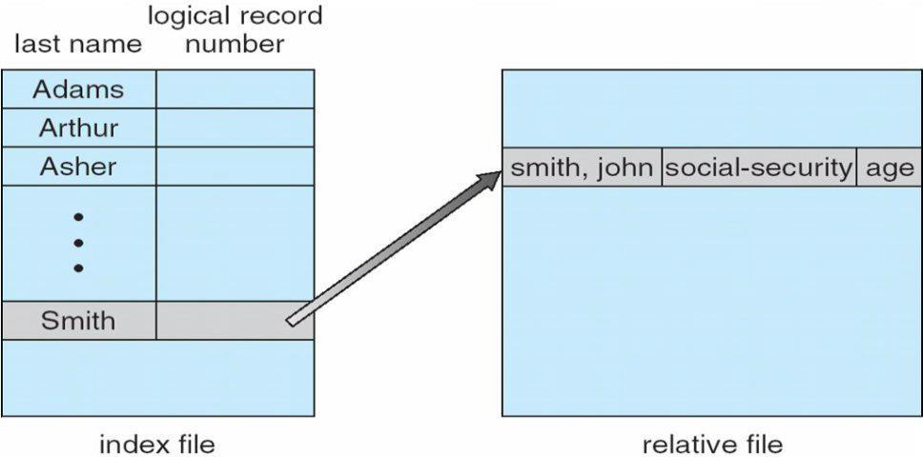
File System
FACULTY OF
ENGINEERING
AND TECHNOLOGY

Slide 11
File System
Relative Files
A relative file is a file in which each record is identified by its ordinal position in the file (record 1, record 2 and so on).
This means that records can be accessed randomly as well as sequentially:
For sequential access, simply execute a READ or WRITE statement to access the next record in the file.
For random access, define a data item as the relative key. Then specify in the data item the ordinal number of the record that you need to READ or WRITE.
Because records can be accessed randomly, access to relative files is fast.
You can declare variable length records for a relative file, this can be wasteful of disk space.
FACULTY OF
ENGINEERING
AND TECHNOLOGY

Slide 12
File System
As relative files always contain fixed length records, no space is saved by specifying data compression.
Each record in a relative file is followed by a two-byte record marker which indicates the current status of the record.
The status of a record can be:
x"0A" - record present
x"00" - record deleted or never written
When you delete a record from a relative file, the record's contents are not removed immediately.
The record's record marker is updated to show that it has been deleted, but the contents of the deleted record remain physically in the file until a new record is written.
FACULTY OF
ENGINEERING
AND TECHNOLOGY

Slide 13
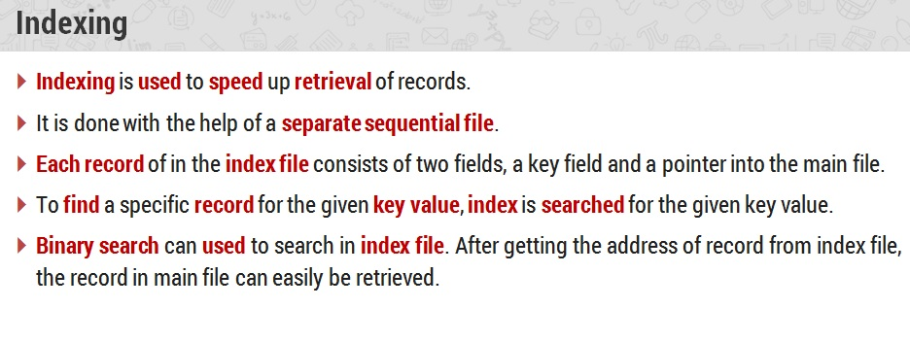
File System
Indexed file organization
FACULTY OF
ENGINEERING
AND TECHNOLOGY

Slide 14
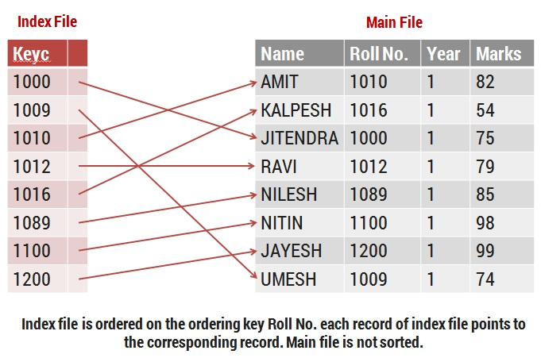
File System
FACULTY OF
ENGINEERING
AND TECHNOLOGY

Slide 15
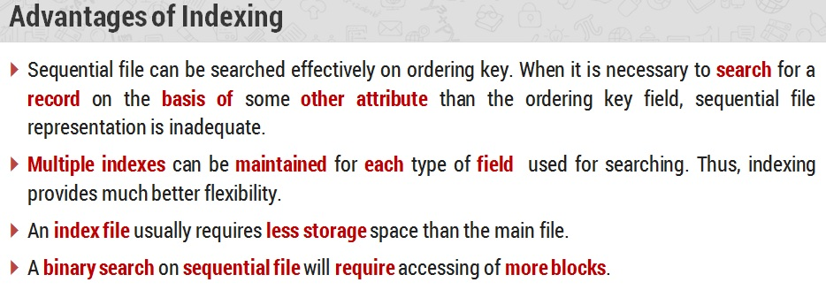
File System
FACULTY OF
ENGINEERING
AND TECHNOLOGY

Slide 16
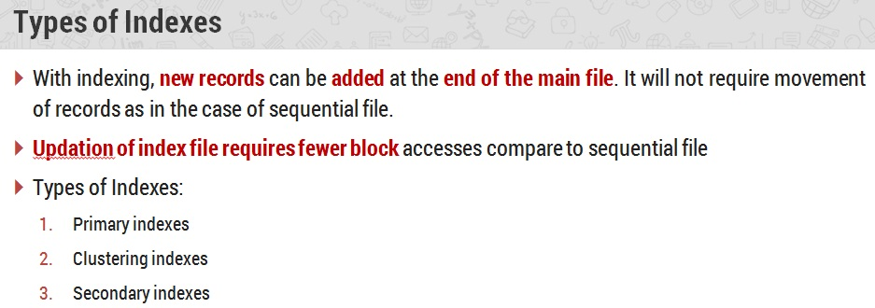
File System
FACULTY OF
ENGINEERING
AND TECHNOLOGY

Slide 17
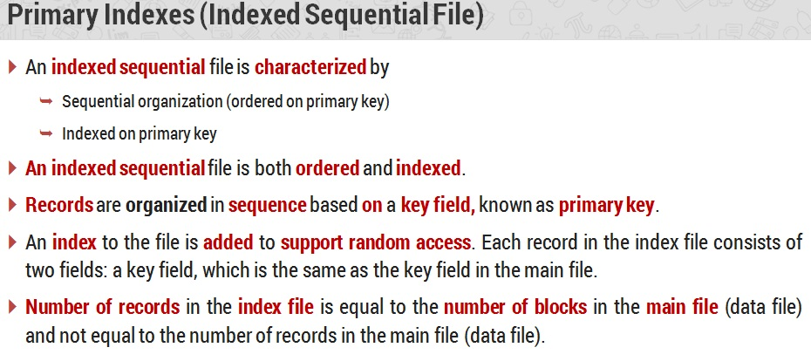
File System
FACULTY OF
ENGINEERING
AND TECHNOLOGY

Slide 18
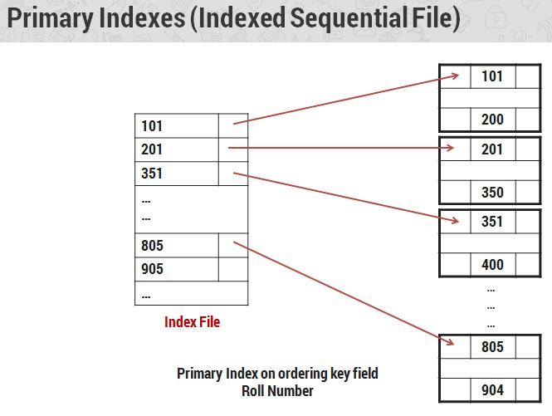
File System
FACULTY OF
ENGINEERING
AND TECHNOLOGY

Slide 19
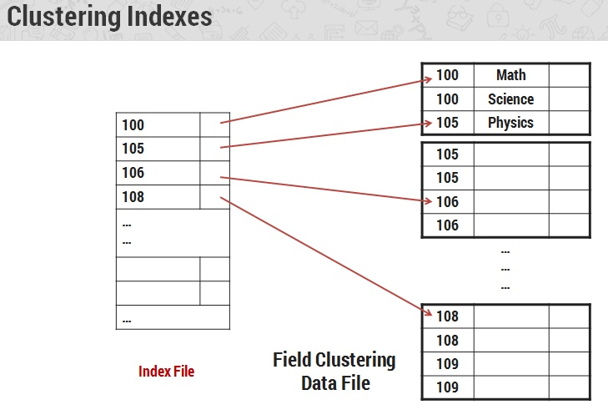
File System
FACULTY OF
ENGINEERING
AND TECHNOLOGY

Slide 20
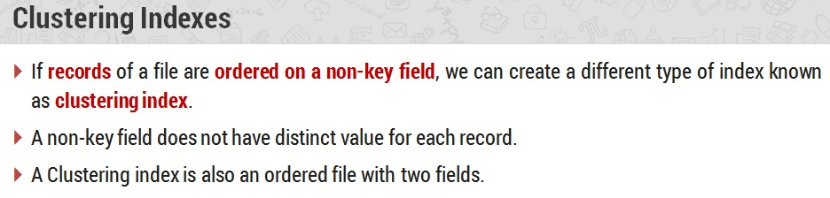
File System
FACULTY OF
ENGINEERING
AND TECHNOLOGY

Slide 21
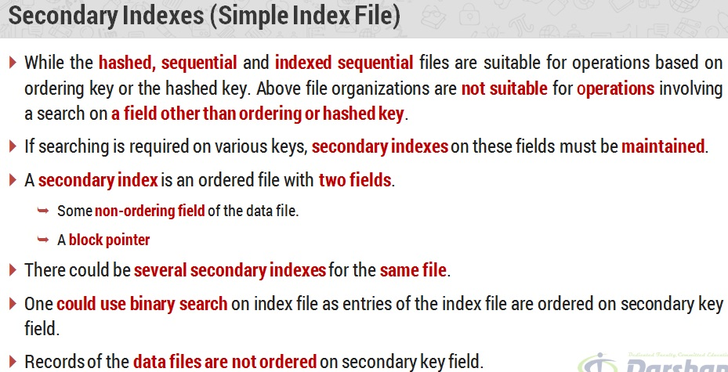
File System
FACULTY OF
ENGINEERING
AND TECHNOLOGY

Slide 22
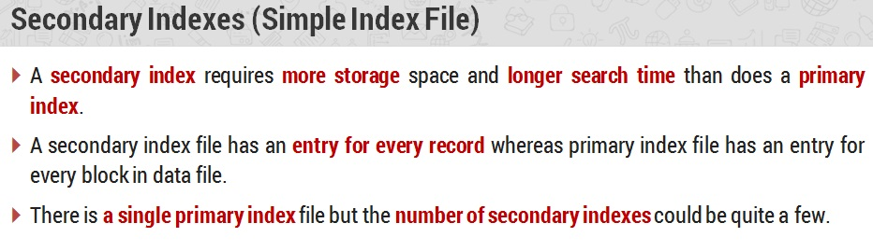
File System
FACULTY OF
ENGINEERING
AND TECHNOLOGY

Slide 23
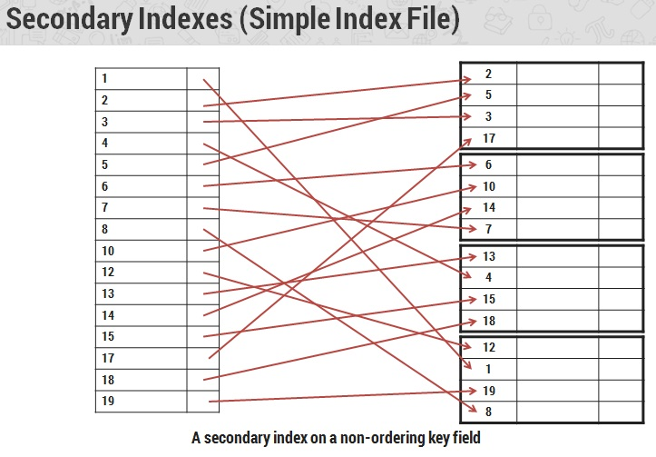
File System
FACULTY OF
ENGINEERING
AND TECHNOLOGY

Slide 24
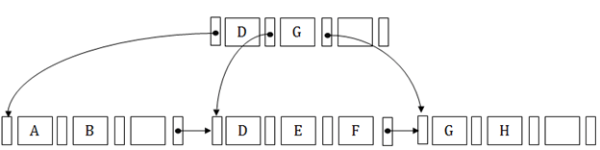
File System
B+ Tree as Index
The B+ tree is a balanced binary search tree. It follows a multi-level index format.
In the B+ tree, leaf nodes denote actual data pointers. B+ tree ensures that all leaf nodes remain at the same height.
In the B+ tree, the leaf nodes are linked using a link list. Therefore, a B+ tree can support random access as well as sequential access.
Structure of B+ Tree
FACULTY OF
ENGINEERING
AND TECHNOLOGY

Slide 25
File System
In the B+ tree, every leaf node is at equal distance from the root node.
The B+ tree is of the order n where n is fixed for every B+ tree.
It contains an internal node and leaf node.
Internal node
An internal node of the B+ tree can contain at least n/2 record pointers except the root node.
At most, an internal node of the tree contains n pointers.
Leaf node
The leaf node of the B+ tree can contain at least n/2 record pointers and n/2 key values.
At most, a leaf node contains n record pointer and n key values.
FACULTY OF
ENGINEERING
AND TECHNOLOGY

Slide 26
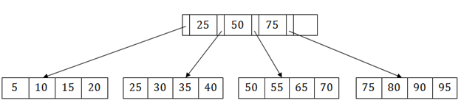
File System
Every leaf node of the B+ tree contains one block pointer P to point to next leaf node.
Searching a record in B+ Tree
Suppose we have to search 55 in the below B+ tree structure.
First, we will fetch for the intermediary node which will direct to the leaf node that can contain a record for 55.
So, in the intermediary node, we will find a branch between 50 and 75 nodes.
Then at the end, we will be redirected to the third leaf node. Here DBMS will perform a sequential search to find 55.
FACULTY OF
ENGINEERING
AND TECHNOLOGY

Slide 27
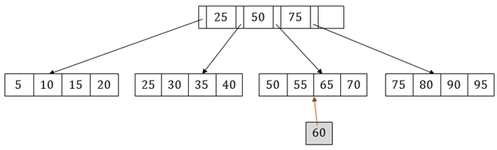
File System
B+ Tree Insertion
Suppose we want to insert a record 60 in the below structure.
It will go to the 3rd leaf node after 55.
It is a balanced tree, and a leaf node of this tree is already full, so we cannot insert 60 there.
In this case, we have to split the leaf node, so that it can be inserted into tree without affecting the fill factor, balance and order.
The 3rd leaf node has the values (50, 55, 60, 65, 70) and its current root node is 50.
FACULTY OF
ENGINEERING
AND TECHNOLOGY

Slide 28
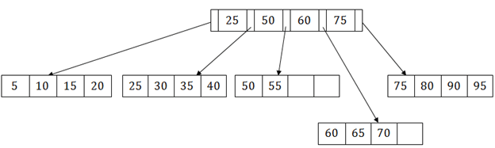
File System
We will split the leaf node of the tree in the middle so that its balance is not altered.
So we can group (50, 55) and (60, 65, 70) into 2 leaf nodes.
If these two has to be leaf nodes, the intermediate node cannot branch from 50.
It should have 60 added to it, and then we can have pointers to a new leaf node.
This is how we can insert an entry when there is overflow.
FACULTY OF
ENGINEERING
AND TECHNOLOGY

Slide 29
File System
MULTIKEY FILE ORGANISATION
A family of file organisation schemes that allow records to be accessed by more than one key field.
We have considered only single-key file organisation.
Sequential, by a given key; direct access by a particular key; and indexed sequential giving both direct and sequential access by a single key.
Those file organisation that enable a single data file to support multiple access paths, each by a different key.
These file organisation techniques are at the heart of database implementation.
The ability to search on many keys is enabled by building multiple index files (multikey file organisation) “on top of” the data file.
FACULTY OF
ENGINEERING
AND TECHNOLOGY

Slide 30
File System
The physical database then consists of one or more data files and many index files, and each data file contains either one or several record types.
Each index file supports access by a particular field or group of fields.
There are numerous techniques that have been used to implement multi key file organisation.
Multi list file organisation
Inverted file organisation
FACULTY OF
ENGINEERING
AND TECHNOLOGY

Slide 31
File System
Multi list file organisation
The basic approach to providing the linkage between an index and the file of data records is called multilist organisation.
A multilist file maintains an index for each secondary key.
The index for secondary key contains, instead of a list of primary keys related to that secondary key, only one primary key value related to that secondary key.
That record will be linked to other records containing the same secondary key in the data file.
Linking records together in order of increasing primary key value facilitates easy insertion and deletion once the place at which the insertion or deletion to be made is known.
FACULTY OF
ENGINEERING
AND TECHNOLOGY

Slide 32

File System
Searching for a record with a given primary key value is difficult when no index is available, since the only search possible is a sequential search.
To facilitate searching on the primary key as well as on secondary keys, it is customary to maintain several indexes, one for each key.
Using an index in this way reduces the length of the lists and thus the search time.
T_link points to the record of another employee with same title.
D_link points to the record of another employee who works in the same department.
FACULTY OF
ENGINEERING
AND TECHNOLOGY

Slide 33
File System
Inverted File Organisation
In inverted file organisation, a linkage is provided between an index and the file of data records.
A key’s inverted index contains all of the values that the
key presently has in the records of the data file.
Each key-value entry in the inverted index points to all of the data records that have the corresponding value.
Inverted files represent one extreme of file organisation in which only the index structures are important.
The records themselves may be stored in any way (sequentially ordered by primary key, random, linked ordered by primary key etc.).
FACULTY OF
ENGINEERING
AND TECHNOLOGY

Slide 34
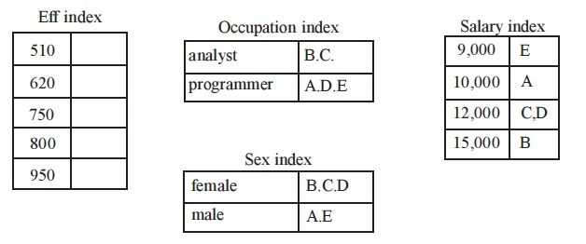
File System
FACULTY OF
ENGINEERING
AND TECHNOLOGY

Slide 35
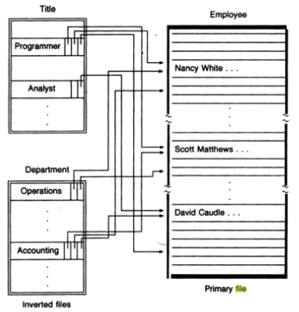
File System
FACULTY OF
ENGINEERING
AND TECHNOLOGY

Slide 36
File System
Inverted files may also result in space saving compared with other file structures.
Both inverted files and multilist files have:
An index for each secondary key.
An index entry for each distinct value of the secondary key.
The index may be tabular or tree-structured.
The entries in an index may or may not be sorted.
The pointers to data records may be direct or indirect.
The indexes differ in that
An entry in an inverted index has a pointer to each data record with that value.
An entry in a multi list index has a pointer to the first data record with that value.
FACULTY OF
ENGINEERING
AND TECHNOLOGY

Slide 37
File System
Hash File
Hashing is an efficient technique to directly search the location of desired data on the disk without using index structure.
Data is stored at the data blocks whose address is generated by using hash function.
The memory location where these records are stored is called as data block or data bucket.
FACULTY OF
ENGINEERING
AND TECHNOLOGY

Slide 38
File System
Hash File
Hash File Organization:
Data bucket – Data buckets are the memory locations where the records are stored. These buckets are also considered as Unit Of Storage.
Hash Function – Hash function is a mapping function that maps all the set of search keys to actual record address.
Generally, hash function uses the primary key to generate the hash index – address of the data block.
Hash function can be simple mathematical function to any complex mathematical function.
Hash Index-The prefix of an entire hash value is taken as a hash index.
Every hash index has a depth value to signify how many bits are used for computing a hash function.
These bits can address 2n buckets.
FACULTY OF
ENGINEERING
AND TECHNOLOGY

Slide 39
File System
Static Hashing:
In static hashing, when a search-key value is provided, the hash function always computes the same address.
For example, if we want to generate an address for STUDENT_ID = 104 using mod (5) hash function, it always results in the same bucket address 4.
There will not be any changes to the bucket address here.
Hence a number of data buckets in the memory for this static hashing remain constant throughout.
FACULTY OF
ENGINEERING
AND TECHNOLOGY

Slide 40
File System
Operations:
Insertion – When a new record is inserted into the table, The hash function h generates a bucket address for the new record based on its hash key K.
Bucket address = h(K)
Searching – When a record needs to be searched, The same hash function is used to retrieve the bucket address for the record.
For Example, if we want to retrieve the whole record for ID 104, and if the hash function is mod (5) on that ID, the bucket address generated would be 4.
Then we will directly got to address 4 and retrieve the whole record for ID 104. Here ID acts as a hash key.
FACULTY OF
ENGINEERING
AND TECHNOLOGY

Slide 41
File System
Deletion – If we want to delete a record, Using the hash function we will first fetch the record which is supposed to be deleted.
Then we will remove the records for that address in memory.
Updation – The data record that needs to be updated is first searched using hash function, and then the data record is updated.
FACULTY OF
ENGINEERING
AND TECHNOLOGY

Slide 42
File System
If we want to insert some new records into the file But the data bucket address generated by the hash function is not empty or the data already exists in that address.
This becomes a critical situation to handle.
This situation in the static hashing is called bucket overflow.
Some commonly used methods are discussed below:
Open Hashing –
In Open hashing method, next available data block is used to enter the new record, instead of overwriting the older one.
This method is also called linear probing.
For example, D3 is a new record that needs to be inserted, the hash function generates the address as 105.
But it is already full. So the system searches next available data bucket, 123 and assigns D3 to it.
FACULTY OF
ENGINEERING
AND TECHNOLOGY

Slide 43
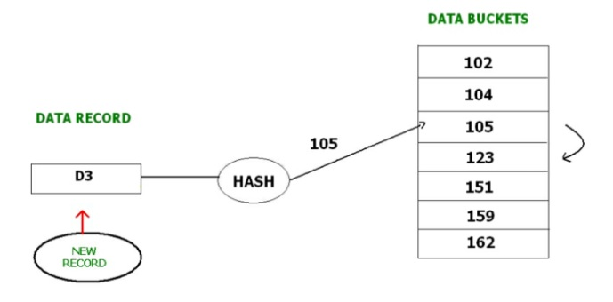
File System
FACULTY OF
ENGINEERING
AND TECHNOLOGY

Slide 44
File System
Closed hashing –
In Closed hashing method, a new data bucket is allocated with same address and is linked it after the full data bucket.
This method is also known as overflow chaining.
For example, we have to insert a new record D3 into the tables.
The static hash function generates the data bucket address as 105. But this bucket is full to store the new data.
In this case is a new data bucket is added at the end of 105 data bucket and is linked to it. Then new record D3 is inserted into the new bucket.
FACULTY OF
ENGINEERING
AND TECHNOLOGY

Slide 45
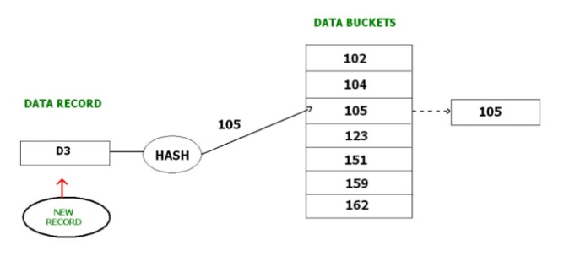
File System
FACULTY OF
ENGINEERING
AND TECHNOLOGY

Slide 46
File System
Dynamic Hashing –
The drawback of static hashing is that it does not expand or shrink dynamically as the size of the database grows or shrinks.
In Dynamic hashing, data buckets grows or shrinks (added or removed dynamically) as the records increases or decreases.
Dynamic hashing is also known as extended hashing.
In dynamic hashing, the hash function is made to produce a large number of values.
For Example, there are three data records D1, D2 and D3 . The hash function generates three addresses 1001, 0101 and 1010 respectively.
This method of storing considers only part of this address – especially only first one bit to store the data. So it tries to load three of them at address 0 and 1.
FACULTY OF
ENGINEERING
AND TECHNOLOGY

Slide 47
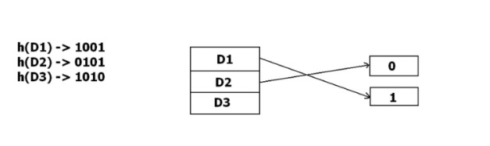
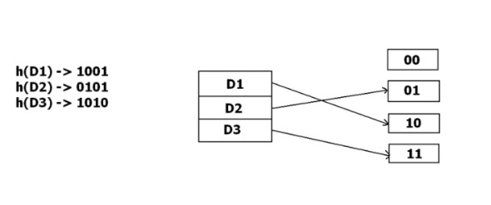
File System
But the problem is that No bucket address is remaining for D3. The bucket has to grow dynamically to accommodate D3.
So it changes the address have 2 bits rather than 1 bit, and then it updates the existing data to have 2 bit address.
Then it tries to accommodate D3.
FACULTY OF
ENGINEERING
AND TECHNOLOGY

